Slide 1
The Art of Doing with a Highly Disciplined Mindset
Andrés M. Guiot-Isaac
Jimena Hurtado

Slide 2
Plan
Economics education at Universidad de los Andes.
Call to change economic education.
Assessing our strengths and challenges.
New curriculum.

Slide 3
1. Economics education at Universidad de los Andes

Slide 4
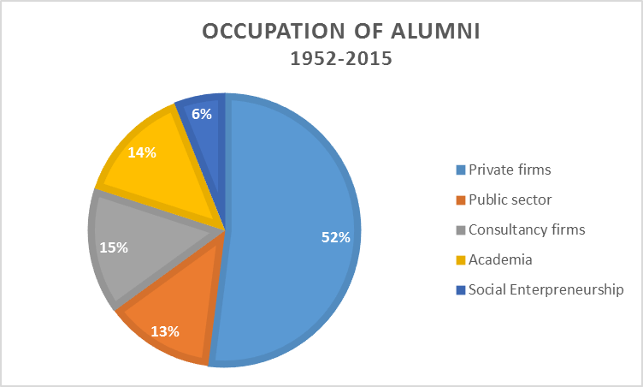
Economics Department
Source: Vice-Chancellory Development and Alumni
Notes:
1948
QS Ranking 2018
Pontificia Universidad Católica de Chile
Universidad de los Andes
Universidad de Sao Paulo
Fundación Getulio Vargas
Universidad Nacional Autónoma de México
Repec 2018
Universidad de Chile
PUC Chile
Getulio Vargas
Uniandes.
Professionalizing education
Answers of 2176 individuals in 2016.
Demand for professional economists since 1948 associated with development policies.

Slide 5
QS Ranking 2018 | University | Country | Economic component of the curriculum (%)
1 | Harvard | United States | 40%
2 | MIT | United States | 52%
3 | Stanford | United States | 44%
4 | Berkeley | United States | 37%
7 | LSE | United Kingdom | 95%
101 | Universidad de los Andes | Colombia | 88%
Notes:
Research department: important detail – students are not like us; they do not have the same preferences or expectations as their professors. We had to learn what we have in common: believing economics can make the world a better place. We had lost that: question we ask first year students and then seniors.

Slide 6
2. Changes in economic education
Notes:
International movement.

Slide 7
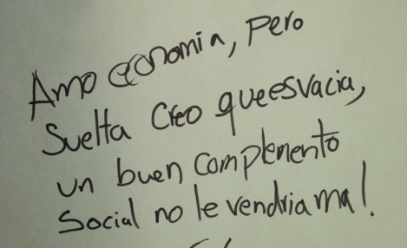
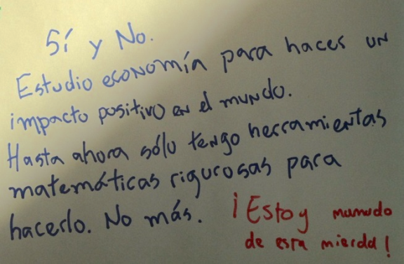
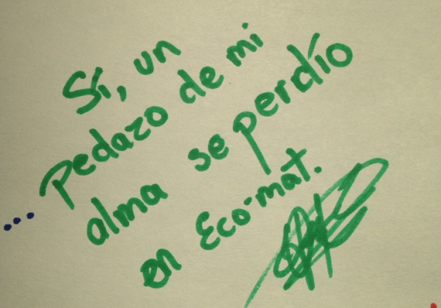
Need to adjust
Notes:
Question: do you like your program?
“I love economics, put on its own I feel it’s empty, a good social complement would fit in nicely”
“Yes and no. I study economics to have a positive impact in the world. Until now I only have rigurous economic tools to do it. Nothing else. I am sick of this shit”.
“Yes. A part of my soul was lost in mathematical economics”.

Slide 8


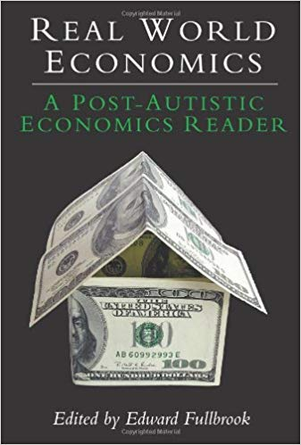



In other places

Slide 9
3. Assessment
Notes:
Starting point: solid technical formation.
Hansen’s proficiencies (1986; 2001)
Access existing knowledge
Display command of existing knowledge
Interpret existing knowledge
Interpret and manipulate economic data
Apply existing knowledge
Create new knowledge
Process: at least three years formal discussions with several years of informal discussions between all members: faculty, students, alumni and administrative staff.
What came out of the process was the “aha moment”: all the stuff students learn will make sense at some point and they will SEE that it helps them to think in an orderly fashion to solve social problems and answer social demands.
Helping them make sense and make the aha moment explicit, what leads to that point, how we know we got there, and how do we use it.
Shared assessment (Siegfried et al 1991) American Association of Colleges invited the AEA.

Slide 10
Think like an economist
“To think like an economist involves a highly disciplined ‘mind-set’, yet one that is creative - willing to speculate about alternative relationships and to examine their implications” (Siegfried et al. 1991: 200)
Notes:
Problem: no opportunity to do economics.
Recommendation: capstone courses.
McGoldrick et al. (2017):
More than 2/3 of top 30 universities and liberal colleges ask for thesis or capstone courses, but 10% of majors complete thesis.
Capstone courses associated with seminars, senior thesis, content specific (electivas). We already had that precisely because of the characteristic features of economic education in the region: professionalizing., highly technical. Many of our undergraduate students are research assistants.
What then?
Go to the basics:
What is economics?
What are the main features of an economist?

Slide 11
Economics
Economics studies how human beings use scarce productive resources like capital, labor, natural resources, knowledge in specific institutional settings, with the goal of distributing goods and services to satisfy the needs of the members of society in an efficient, just and sustainable way.
Notes:
Definition not of what it is but of what it does. Economics implies action, change and well-being.

Slide 12
Profile What do they do?
Through an ethical and integral training, the graduates of the undergraduate program in Economics develop analytical skills that make them innovative and critical thinkers capable of proposing and designing adequate solutions to the challenges of their own context.

Slide 13
Profile How do they do it?
With a solid conceptual structure product of their command of macroeconomics, microeconomics, the history of facts and ideas, and quantitative tools, graduates can identify and understand the country’s problems using a research and applied perspective in their professional career be it in the private or public sectors.

Slide 14
Proficiencies
Critical thinking: ability to choose between theoretical and methodological tools to identify and solve economic problems.
Teamwork: ability to work collaboratively with others, taking advantage of their strengths and comparative advantages, to propose consensual solutions that synthetize individual contributions.
Effective communication: ability to communicate clearly, whether in oral of written form, ideas, proposals and criticisms, considering both audience and context in which they are.
Ethical judgement: the sensitivity and practical wisdom to understand, identify and judge both the ethical foundations and the ethical implications of their performative role as economists in private and public settings.

Slide 15
Se vale pensar
Entender para hacer
La economía es un arte
Notes:
Mental structure of an economist. Thinking like an economist.

Slide 16
New Curriculum

Slide 17
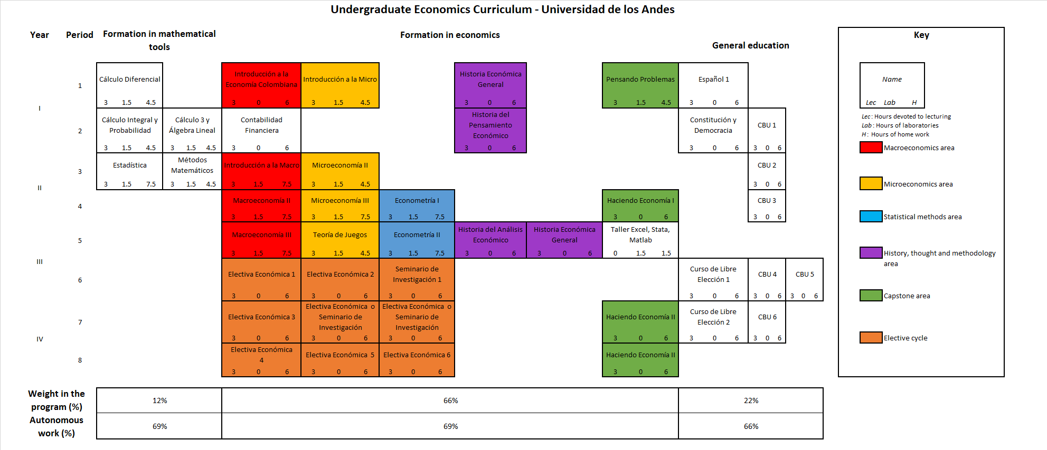

Slide 18
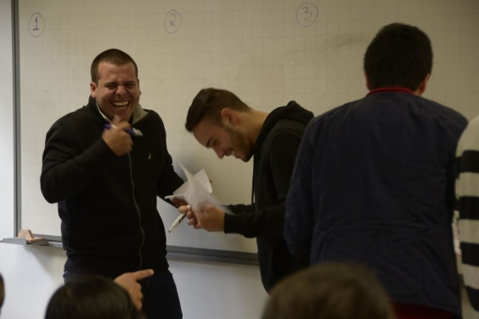
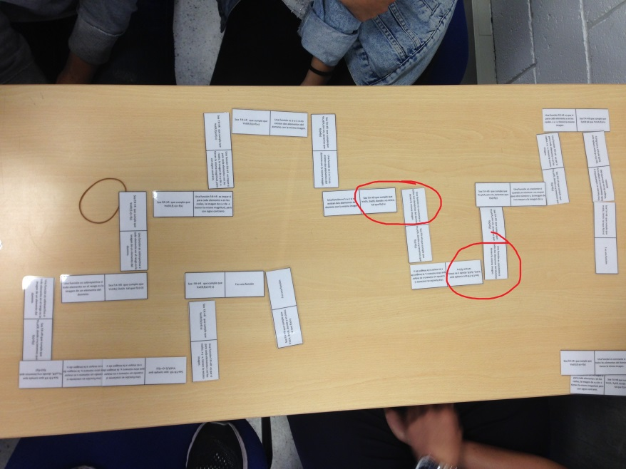
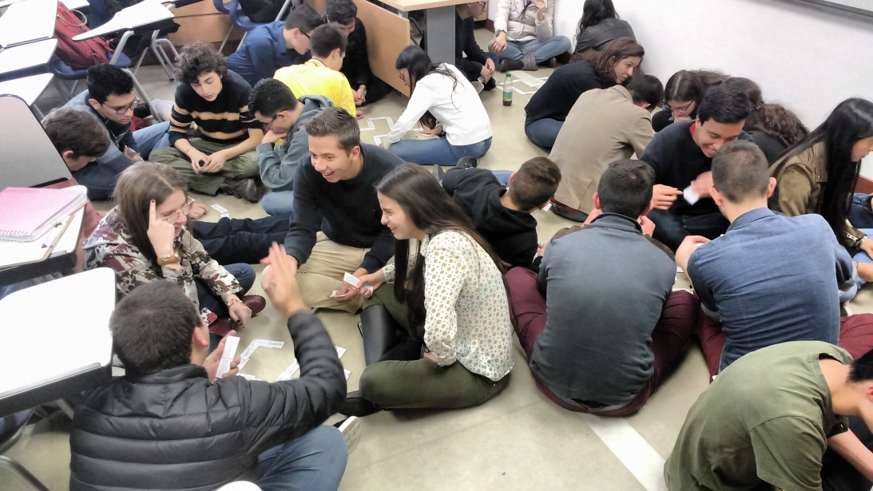
Thinking problems
Notes:
Three proficiencies:
Logical aptitudes
Critical thinking
The ability to understand and use mathematics as a language.
Sets, matrixes, functions and algorithms.

Slide 19
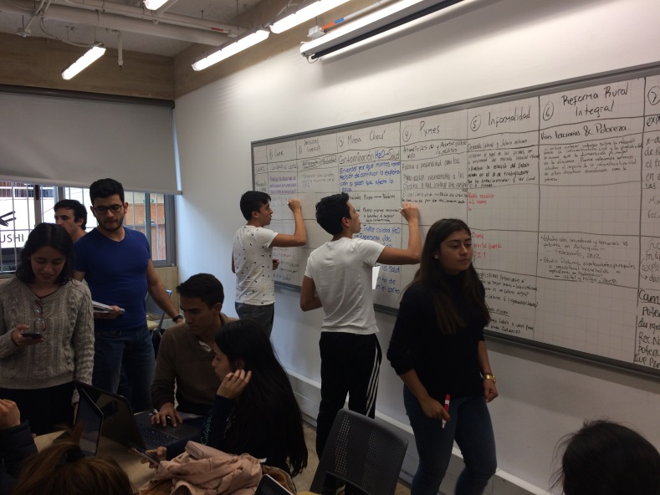
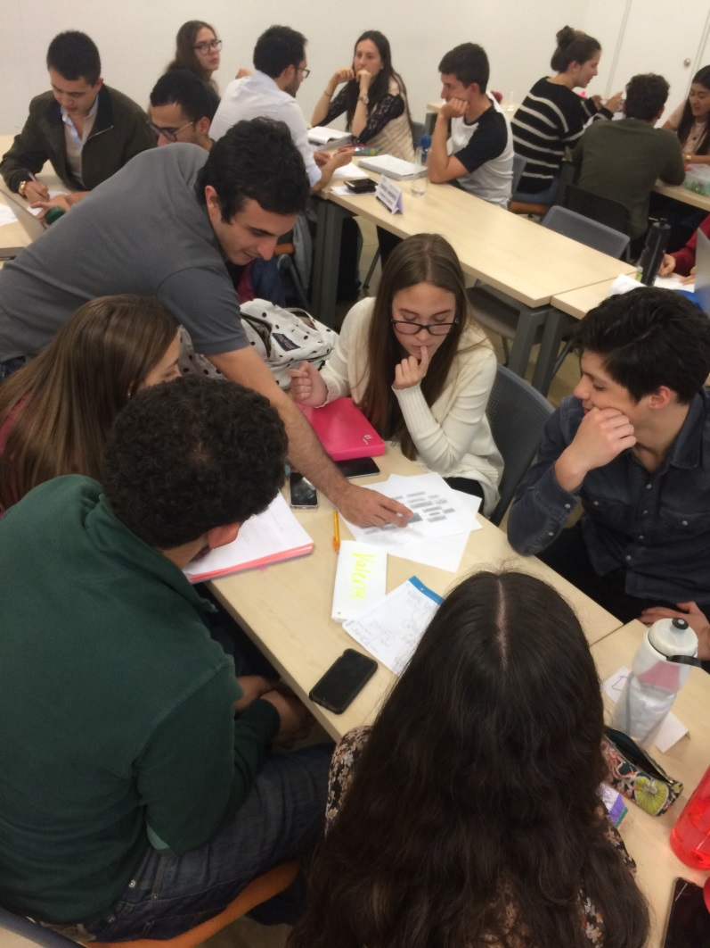
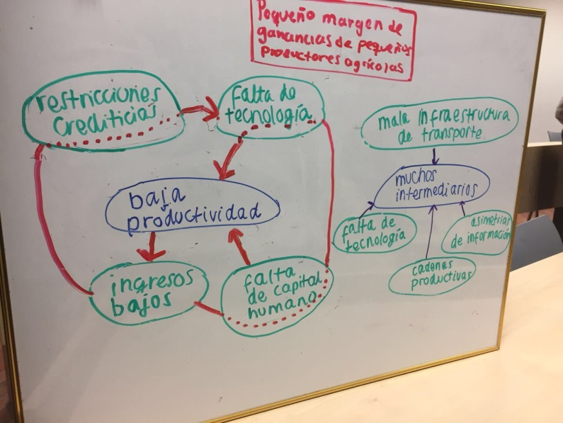
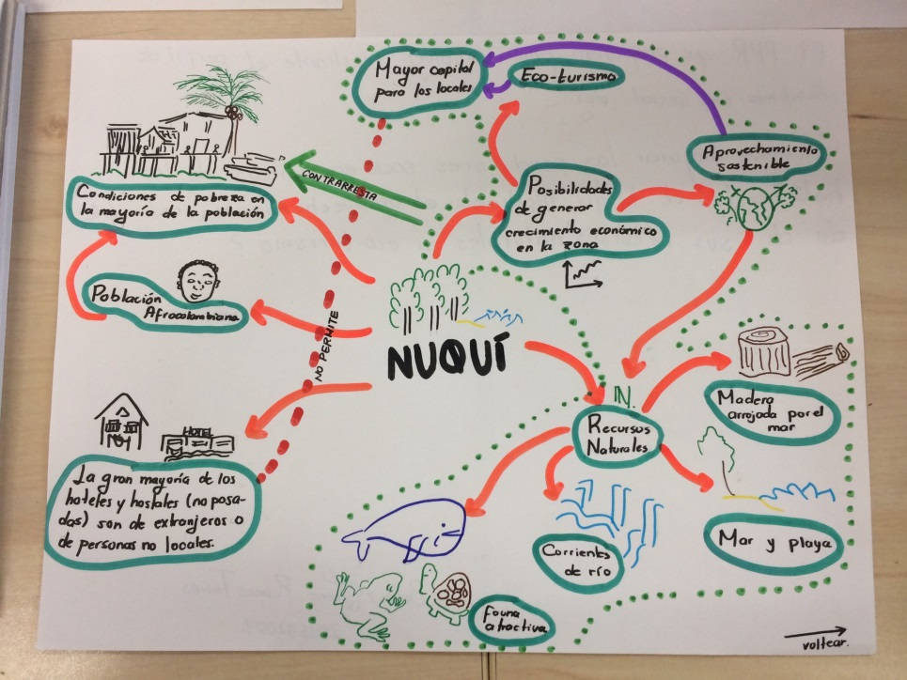
Doing Economics 1
Notes:
DE1:
Moments:
What makes us economists? Thinking like an economist – method.
What do economists do? Professional profiles.
Choose a topic: question, problem, challenge.
Assessing the QPC
Solving the QPC

Slide 20
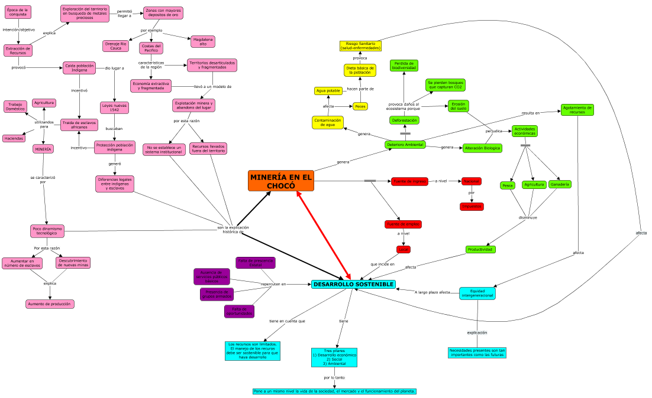
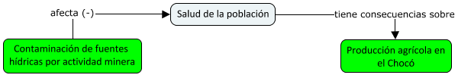

Slide 21
How are we doing?
Course | Former curriculum |  | Reformed curriculum
 | Fail (%) | Withdraw (%) | Fail (%) | Withdraw (%)
Precalculus | 21 | 2 | 17 | 0
Differential calculus | 21 | 12 | 13 | 13
Integral calculus | 18 | 14 | 7 | 3
Linear algebra | 16 | 10 | 10 | 7
Notes:
Around 850 students 2013-2 – 2016-1, only those who took the course for the first time.
2016-2: 102 students.

Slide 22
How are we doing?
Social interactions between students and professors.
Fun.
Space to explore their own interests and what they want to do as professional economists.
DE: finally see what all this is good for.
Making sense of their own educational process.
Notes:
Oral SETs:
PP since 2016-2
HE 1 once
HE 2 not yet, however joint design of the courses.

Slide 23
Thank you
am.guiot699@uniandes.edu.co jihurtad@uniandes.edu.co

